Slide 1
Advance Electronic I
THIRD YEAR
Lecturer: Abbas S.
Hameed
Main References:
1- Robert L. Boylestad and Louis Nashelsky, “ Circuit Theory “.
Electronic
Devices and
2- Thomas L. Floyd, “ Electronic
Devices. CCV “.
3- Adel S. Sedra and Kenneth Carless Smith, “ Microelectronic circuits “.

Slide 2
OPERATIOAL AMPLIFIER
Chapter Three Lect 10

Slide 3
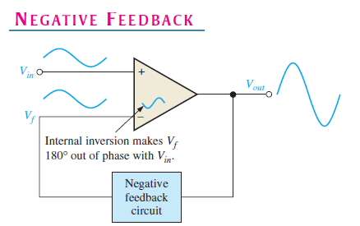

Slide 4
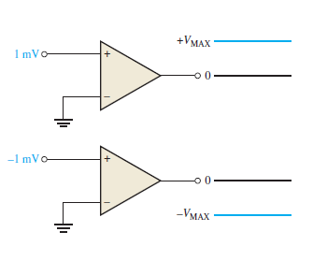
Why Use Negative
Feedback?

Slide 5
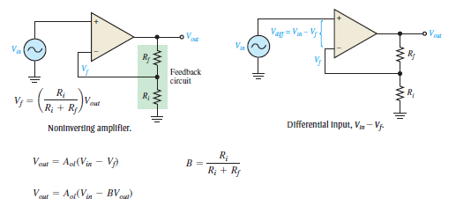
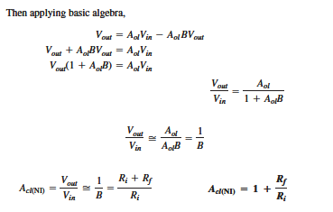
Noninverting Amplifier

Slide 6
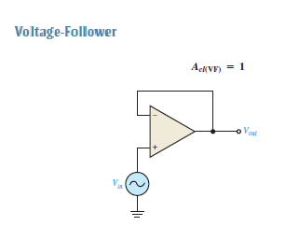

Slide 7
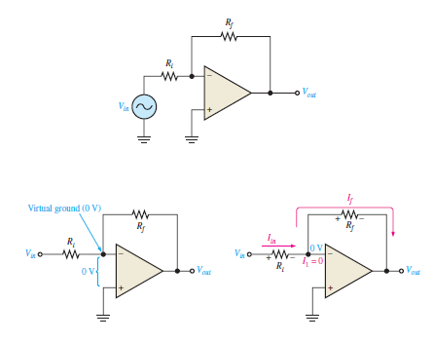
Inverting Amplifier

Slide 8
